Slide 1
Socialinė Psichologija Odontologijoje
Doc. Dr. Jolanta Aleksejūnienė
Odontologijos Fakultetas, Britų Kolumbijos Universitetas, Vankuveris, Kanada
Vilnius, 2019 Rugsėjo 27

Slide 2
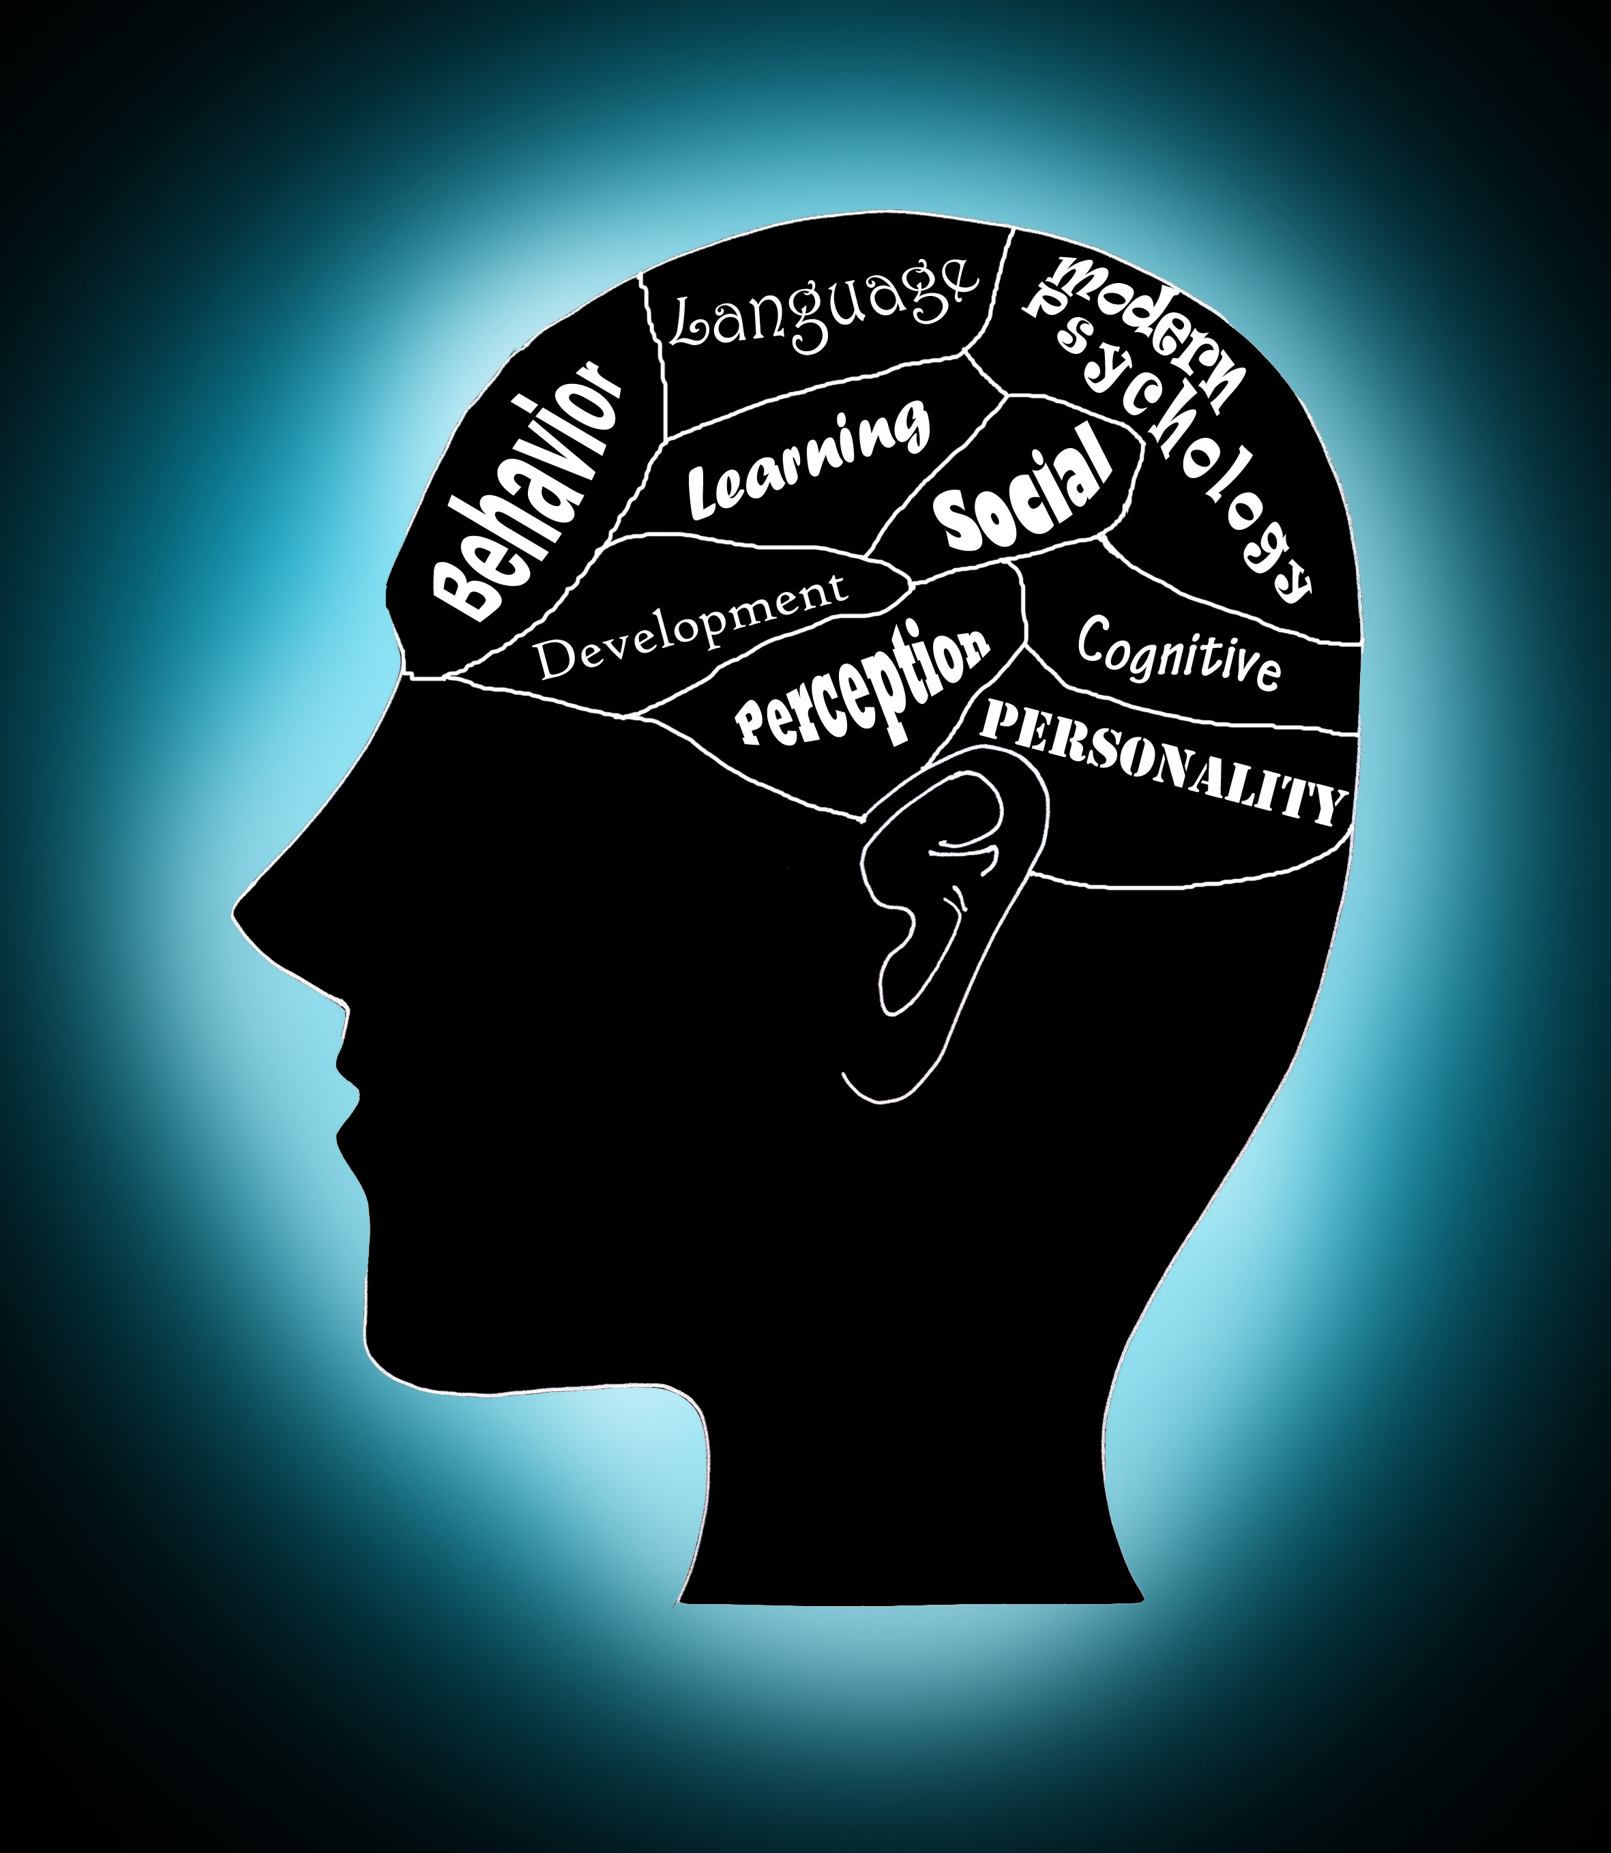
Pranešimo planas
Odontologija – tai socialinis profesinis įsipareigojimas
Psichologija odontologijoje
Bendravimas su nebendradarbiaujančiais pacientais ir jų priežiūra
Skausmo psichologija
Bendravimo rūšys (įprastinis žodinis ir kūno kalba)
Kelios efektyvios komunikacijos strategijos
Pacientų motyvacija
Odontologų perdegimo sindromas

Slide 3
Odontologija – tai socialinis įsipareigojimas
Odontologijos profesija yra paremta visuomenės poreikiu palengvinti su burnos ligomis susijusias kančias.
Mainais į tai, visuomenė odontologo profesijai priskiria aukštesnį socialinį statusą, geras pajamas ir odontologinės praktikos apsaugą.
Svarbi šio susitarimo dalis yra abipusis pasitikėjimas ir leidimas odontologijos profesijai veikti savireguliacijos pagrindu.
Holden ACL. Self-regulation of dentistry and the social contract. British Dental Journal. 2016; 221: 449-451.

Slide 4
Psichologija Odontologijoje
Sveikatos psichologija: mokslas apie žmonių elgesį sveikatos, ligų profilaktikos ir kitose su sveikata susijusiose srityse.
Psichologija yra svarbi bendradarbiavime tarp paciento ir sveikatos specialisto.
Sveikatos išsaugojimo skirtumai siejami su psichosocialiniais rizikos veiksniais.
Psichologinės teorijos naudingos ruošiant intervencijas, kurios bus efektyvesnės nei įprasti pacientų švietimo informavimo būdai.
Scambler S, Scott SE, Asimakopoulou K. Sociology and Psychology for the Dental Team. 2016. Dziaugyte L et al. Self-efficacy theory-based intervention in adolescents: a cluster randomized trial-focus on oral self-care practice and oral self-care skills. Int J Paediatr Dent. 2017; 27(1):37-46. doi: 10.1111/ipd.12223. Epub 2016 Jan 13. Aleksejūnienė J, Brukienė V. A cluster randomized theory-guided oral hygiene trial in adolescents –A latent Growth model. Int J Dent Hyg. 2017 May 17. doi: 10.1111/idh.12286. Epub ahead of print.

Slide 5
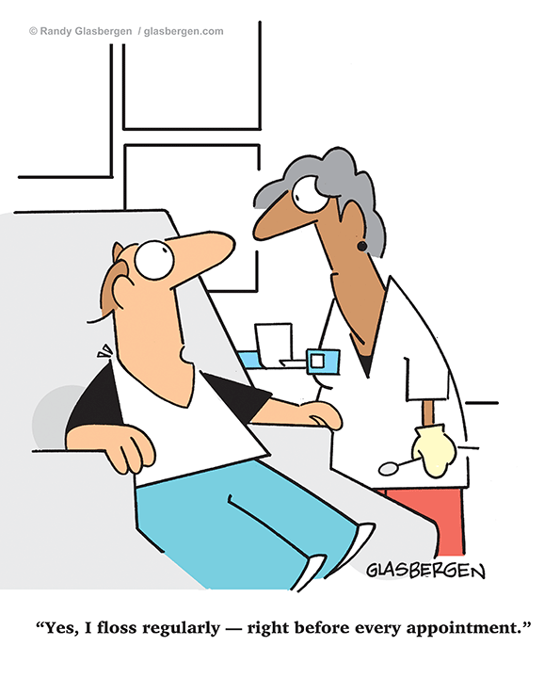
Pacientai, nesilaikantys stomatolgo rekomendacijų
Praleidžia odontologinius vizitus arba pavėluoja.
Nepradeda suplanuoto odontologinio gydymo.
Gydymo metu nesugeba laikytis tinkamo elgesio.
Per anksti nutraukia suplanuotą gydymą.
Imasi veiksmų, kurie nebuvo numatyti planuojant gydymą (pvz. savigyda).
Misra S, Daly B, Dunne S, Millar B, Packer M, Asimakopoulou K (2013). Dentist-patient communication: what do patients and dentists remember following a consultation? Implications for patient compliance. Patient Prefer Adherence, 7, 543-9.

Slide 6
Kliūtys savalaikiam dantų gydymui
Pagrindinės: dantų gydymo baimė ir gydymo kaina.
Kitos: nejaukus laukiamasis, paciento negalėjimas kontroliuoti esamos situacijos, nepriimtina odontologo asmenybė, gydymo procedūrų kvapai ir garsai, elgesys su pacientu lyg jis būtų tiesiog “burna”.
Gero odontologo bruožai: draugiškas, empatiškas, profesionalus, paaiškina prieš gydymą, ką ruošiasi daryti/gydymo kainą, besirūpinantis, švelnus, keliantis pacientui pasitikėjimą.
Scambler S, Scott SE, Asimakopoulou K. Sociology and Psychology for the Dental Team. 2016.

Slide 7
Nebendradarbiaujančių pacientų valdymas: ką daryti ir ko ne
NE…
Nekaltinkite pacientų dėl bendradarbiavimo stokos.
Nekeiskite gydymo plano dėl pavienio epizodo.
Nedarykite skubotų išvadų apie paciento kompetencijos trūkumą.
Negrasinkite pacientui jokiomis pasekmėmis!
TAIP…
Paklauskite paciento, kodėl nesilaiko ir kaip supranta gydymo planą.
Suteikite pacientams daugiau informacijos.
Paklauskite paciento, kaip jūs galėtumėte padėti.

Slide 8
Skausmo Psichologija
SKIRTUMAI
Individualūs: skausmo atsako skirtumai (socialiniai, kultūriniai, lyties, etniniai).
Biologiniai: kai kurie medikamentai yra efektyvesni moterims nei vyrams.
SKAUSMO MALŠINIMAS
Įvertinkite paciento individualumą.
Gerbkite paciento autonomiją ir skatinkite paciento bendradarbiavimą.
Pacientams, kurie patiria lėtinį stresą, gali padėti kognityvinė terapija (minčių performavimas).
Joan Maclean. Pain psychology. In: Gilmartin J. Health Psychology in context. Wiley-Blackwell . 2009.
Notes:
Negative view of psychology demonstrating that their pain is all in their mind, or that there is a mental problem. Sensory (<difference) and affective (> difference) components of pain.
In dental setting: specific drugs may be more effective in women than in males and this was associated with hormone differences (testosterone reducing, oestrogen potentiating effects).
Cognitive behavioural therapy for patients with chronic stress (restructuring their thoughts).
Effective interventions focus on uniqueness of each person, respect and encourage active cooperation for changing behaviour.

Slide 9
Simptomų Suvokimo Psichologija
Psichologinės teorijos teigia kad simptomų suvokimas yra netikslus.
Tokie išsireiškimai, kaip: jums neskaudės/jūs nejusite skausmo, pasąmoningai suvokiami kaip jums skaudės.
Simptomų suvokimas yra veikiamas emocijų (individualūs skirtumai) ir kitų veiksnių (aplinka, žinios, įsitikinimai, patirtis).
Pacientai, kurie yra blogos nuotaikos, jaučia 2-3 kartus daugiau simptomų, nei tie, kurie yra geros/puikios nuotaikos.
Nepriskirkite simptomų „senėjimui”, o interpretuokite juos kaip „normalius individualius skirtumus”.
Scambler S, Scott SE, Asimakopoulou K. Sociology and Psychology for the Dental Team. 2016.
Notes:
Psychological theories: symptom perception is subject to inaccuracies.
Avoid phrases such as ‘will not hurt’ or ‘will not feel pain’ are subconsciously interpreted as ‘will hurt’ or ‘pain’, resulting in higher likelihood that a patient will experience pain.
Symptom perception is influenced by emotional (individual differences) as well as contextual factors (patient’s environment, knowledge, beliefs, previous experience).
Subjects will a low mood had 2-3 times more symptoms than the ones with high mood.
Resist to attribute symptoms to ‘aging’, thus interpreting as ‘normal’.

Slide 10
Odontologai turi pažinti savo pacientus!
Odontologai turi nedaug laiko ilgiems pokalbiams su pacientais.
Bendravimas yra svarbus, pašalinant barjerą tarp paciento ir odontologo.
Bendravimo pasekmės dažnai nėra iškart pastebimos.
65% viso bendravimo yra išreiškiama kūno kalba.
Freeman R. Communication with Patients effectively: some practical suggestions.
Gilmartin J. Health Psychology in context. Wiley-Blackwell . 2009
Notes:
Dental professionals within their busy work schedule have little if any time for prolonged patient interviews. Freeman R.1999. HOWEVER, …
Dentists should know their patients!
Consequences of our communication with patients be it excellent, average or poor, are often not immediately observable..
Communication plays a vital role in breaking down barriers between the patient and dental professional and in strengthening treatment alliance.
65% of all communication is non-verbal (actions speak louder than words).

Slide 11
Į pacientą sutelkta priežiūra
Dalinkitės atsakomybe su savo pacientais!
Tai atsakomybė, pagarba paciento pasirinkimams/poreikiams/vertybėms ir užtikrinimas, kad paciento vertybės nulemia visus klinikinius sprendimus.
Bendra atsakomybė - odontologai ir pacientai pasiekia „tarpusavio supratimą/susitarimą“.
Paciento-odontologo susitarimas: problemos apibūdinimas, konkrečių gydymo tikslų/prioritetų nustatymas ir vaidmenų tarp paciento bei odontologo paskirstymas.
Committee of Healthcare in America, 2011, National Health Service in UK. Stewart M, Brown JB, Donner A, Mc Whinney IR, Oates J, Weston WW, Jordan J (2000). The impact of patient-centered care on outcomes. The Journal of Family Practice, 49, 796-804.

Slide 12
Efektyvaus Bendravimo Rezultatai
Padidėjusi kokybė/kiekis informacijos, kurią gaunate ir dalijatės.
Tikslesnis diagnozės nustatymas.
Pacientai labiau laikosi paskirtų gydymo/profilaktikos rekomendacijų.
Abipusis pasitenkinimas (paciento ir sveikatos priežiūros specialisto).
Sumažėjusi pacientų skundų ar teisinių ieškinių galimybė.
Silverman J, Kutz S, Draper J. Skills for communicating with patients 2005. Oxford. Radcliffe Publishing.

Slide 13
Odontologiniai Pacientai
PRISIMENA
Vizito priežastį
Technines procedūras
(pvz., nejautra, plombavimą).
NEPRISIMENA
Veiksmų, kuriuos jie sutiko vykdyti ateityje (pvz., sveika dieta, burnos higiena).
SUMANI (SMART)
Specific - specifiškumas
Measurable - galimybė išmatuoti
Agreed - susitarimas (paciento ir odontologo)
Realistic - realistiškumas
Time-specific - laiko atitikimas
Misra S, Daly B, Dunne S, Millar B, Packer M, Asimakopoulou K (2013). Dentist-patient communication: what do patients and dentists remember following a consultation? Implications for patient compliance. Patient Prefer Adherence, 7, 543-549.
Notes:
To facilitate patient adherence use SMART strategy

Slide 14
Bendravimo kliūtys
Odontologo stresas ir jo/jos nekontroliuojamos emocijos.
Koncentracijos stoka (pvz., daug skirtingų darbų, atliekamų vienu metu).
Bendravimo neatitikimas (informacija žodžias ir kūno kalba nesutampa).
Negatyvi kūno kalba (kaltinanti pacientą).
Notes:
Stress and out-of-control emotion. When you’re stressed or emotionally overwhelmed, you’re more likely to misread other people, send confusing or off-putting nonverbal signals, and lapse into unhealthy knee-jerk patterns of behavior. Take a moment to calm down before continuing a conversation.
Lack of focus. You can’t communicate effectively when you’re multitasking. If you’re planning what you’re going to say next, daydreaming, checking text messages, or thinking about something else, you’re almost certain to miss nonverbal cues in the conversation. You need to stay focused on the moment-to-moment experience.
Inconsistent body language. Nonverbal communication should reinforce what is being said, not contradict it. If you say one thing, but your body language says something else, your listener will likely feel you’re being dishonest. For example, you can’t say “yes” while shaking your head no.
Negative body language. If you disagree with or dislike what’s being said, you may use negative body language to rebuff the other person’s message, such as crossing your arms, avoiding eye contact, or tapping your feet. You don’t have to agree, or even like what’s being said, but to communicate effectively without making the other person defensive, it’s important to avoid sending negative signals.

Slide 15
“CLASS” Strategija
Context: Draugiška gydymo įstaigos aplinka.
Listening: Tinkami odontologo klausymosi ir kalbėjimo įgūdžiai.
Acknowledgement: Paciento jausmų ir vertybių pripažinimas.
Strategy: Su pacientu pasirinkta ir suderinta gydymo strategija.
Summarize: Gydymo ir prevencijos plano apibendrinimas.
Freemcan R. Communication with Patients effectively: some practical suggestions. British Dental Journal. 187(5): 240-244.
Notes:
Class provides and enables dental health practitioners to become proficient in their information retrieval.
Context of the clinical setting (empathetic). Draugiška gydymo įstaigos aplinka.
Listening and questioning skills of the dental health professional. Profesionalumas: tinkami odontologo klausymosi ir kalbėjimo įgūdžiai.
Acknowledgement of patient’s feelings. Paciento jausmų pripažinimas.
Strategy (preventive/restorative) negotiated with a patient. Su pacientu suderinta gydymo strategija.
Summarize treatment & preventive options. Gydymo ir prevencijos pasirinkto plano apibendrinimas.

Slide 16
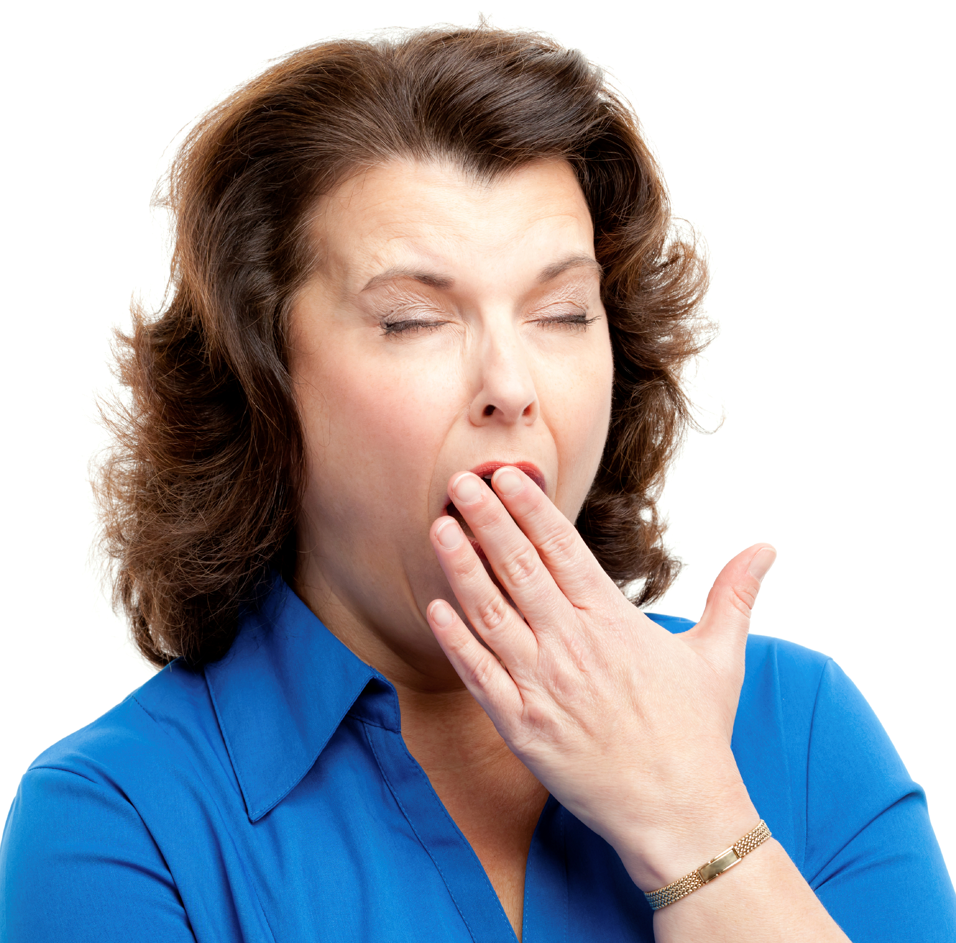
NEVERBALINIS BENDRAVIMAS (kūno kalba)
NETINKAMAS SPECIALISTŲ ELGESYS
Žiūrėjimas kitur, kai pacientas atsako į jūsų klausimus
Kūprinimasis
Stovėjimas virš paciento
Sėdėjimas toliau nuo paciento
PASIRINKITE TINKAMĄ
Pozą
Gestus/judesius
Akių kontaktą
Veido išraišką

Slide 17
TEIGIAMAS NEVERBALINIS BENDRAVIMAS (kūno kalba)
Švari ir organizuota darbo aplinka
Buvimas šalia paciento
Profesionali išvaizda
Bendravimas su pacientu jo akių lygyje
Nedidelis palinkimas link paciento
Paciento privačios erdvės gerbimas
Atsipalaidavimas (rami poza)
Pasisveikinimas ir atsisveikinimas su pacientu
Linktelėjimas galva kada pritariama pacientui
PACIENTAS JAUČIASI PATOGIAI IR SAUGIAI
Kreipkite dėmesį į: pozą, gestus, akių kontaktą, veido išraiškas

Slide 18
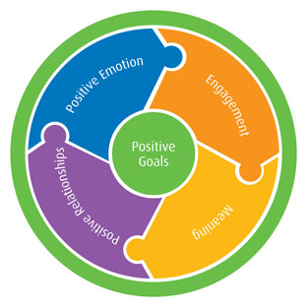
Motyvaciniai pokalbiai
MOTYVACIJA: paskatinkite paciento vidinę motyvaciją keisti nesveikus įpročius.
DARBAS KARTU: Odontologas aktyviai dirba kartu su pacientu.
TIKSLŲ PASIRINKIMAS: strategija, orientuota į paciento skatinimą išsikelti savo tikslus.
ĮTAKA: padidina paciento pasitikėjimą savimi ir efektyvumą.
Boyer BA, Pahari I. (editors) Comprehensive Handbook of Clinical Health Psychology. John Willey & Sons, Inc. 2008.

Slide 19
RULE MOTIVACIJOS PRINCIPAI
R
RESIST venkite sakyti pacientams, ką reikia daryti: jiems nenurodinėkite, nenukreipinėkite jų dėmesio, neįtikinėkite, neprimeskite jiems savo nuomonės.
U
UNDERSTAND supraskite jų motyvaciją: domėkitės jų vertybėmis, poreikiais, galimybėmis, motyvacijomis ir kliūtimis, kurios trukdo keisti jų įpročius.
L
LISTEN klausykitės su empatija: siekite suprasti pacientų vertybes, poreikius, galimybes, motyvacijas ir galimas kliūtis, kurios trukdo jiems keisti įpročius.
E
EMPOWER įgalinkite savo pacientus. Dirbkite kartu su pacientu, kad nustatytumėte specifiškus, realistiškus bei jam/jai pasiekiamus tikslus, raskite strategijas, kurios leistų įveikti iškylančias kliūtis.

Slide 20
MOTYVACIJOS TEORIJA
PIRMINĖ: Automatinė motyvacijos sistema.
ANTRINĖ : Reflektyvi motyvacijos sistema (labiau pažengusi).
Reflektyvi įsijungia tik tuo atveju, kai nugalėta automatinė sistema.
PRIME strategija
Plans (planai)
Responses (reakcija)
Inhibitions (trukdymai)
Motives (motyvai)
Evaluations (vertinimas).
Scambler S, Scott SE, Asimakopoulou K. Sociology and Psychology for the Dental Team. 2016.
Notes:
THEORY of MOTIVATION Automatic motivation system. Behaviour is primarily driven by this system (basic needs and wants, e.g. hunger).
Reflective motivation system is more advanced and includes the person’s belies about good and bad (e.g. sugary foods) , or pre-formed plans.
Reflective system will only act if it can overcome the messages the person is getting from automatic system.

Slide 21
EFEKTYVIOS KOMUNIKACIJOS STRATEGIJA
Paciento įtraukimas į pokalbį
1 DALIS: KLAUSYMASIS (užduodami atviri klausimai)
2 DALIS: PAAIŠKINIMAS (užduodami specifiniai klausimai)
3 DALIS: PATIKSLINIMAS (uždari klausimai)
Notes:
Each phases uses specific questions
PHASE 1 (LISTENING) is associated with encouraging the patient to talk freely and without difficulty.
PHASE 2 (EXPLAINING) making sure that PATIENTS understand what has been discussed and is characterised by negotiating treatment plan.
PHASE 3 (CLARIFICATION) Clarify patient’s expressed and felt needs, with regard to treatment plans and outcome expectations.
Phase 1 OPEN questions to invite and engage the patient in conversation. Open questions facilitate information gathering.
Phase 2: FOCUSED Questions Explaining txs is an integral part of negotiating treatment options and health goals. Dental advise must be clear, concise and to the point. Health education MUST be restricted to maximum of 3-4 essential points. Repeat several times.
Phase 3: ENDING or CLOSING Questions. Closed questions are important as they clarify important points. These are Yes/No questions and are used towards the end of the interview.

Slide 22
Svarbiausi, komunikaciją gerinantys įgūdžiai
PRIMAS ĮGŪDIS: Tapkite įsitraukiančiu (aktyviu) klausytoju
ANTRAS ĮGŪDIS: Kreipkite dėmesį į neverbalinio bendravimo signalus
TREČIAS ĮGŪDIS: Valdykite stresą ir kontroliuokite save

Slide 23
PIRMAS ĮGŪDIS: Tapkite įsitraukiančiu klausytoju
Klausymasis yra pats svarbiausias žodinio bendravimo įgūdis.
Susikoncentruokite į kalbantįjį, jo/jos kūno kalbą, balso toną ir išraiškas.
Venkite įsiterpti ar nukreipti pokalbį kita linkme.
Rodykite savo dėmesį, kalbant apie malonius ar liūdnus dalykus.
Stenkitės vengti kaltinimų.
Notes:
Dr. Hugh McDougall: None of what we do inside our practice is strikingly different than what is done in other practices. We understand that many of our patients employ defense mechanisms when it comes to being at the dentist, so we emphasize the patient having a positive experience.
People will often hear what a person is saying, but will they really listen? We practice a technique called “reflective listening.” It’s so fundamentally simple, but very effective because patients really know that we have heard them. We listen, then paraphrase what our patients have said to make sure that we have understood what they’re saying.
People often focus on what they should say, but effective communication is less about talking and more about listening. Listening well means not just understanding the words or the information being communicated, but also understanding the emotions the speaker is trying to communicate.
There’s a big difference between engaged listening and simply hearing. When you really listen—when you’re engaged with what’s being said—you’ll hear the subtle intonations in someone’s voice that tell you how that person is feeling and the emotions they’re trying to communicate. When you’re an engaged listener, not only will you better understand the other person, you’ll also make that person feel heard and understood, which can help build a stronger, deeper connection between you.
By communicating in this way, you’ll also experience a process that lowers stress and supports physical and emotional well-being. If the person you’re talking to is calm, for example, listening in an engaged way will help to calm you, too. Similarly, if the person is agitated, you can help calm them by listening in an attentive way and making the person feel understood.
If your goal is to fully understand and connect with the other person, listening in an engaged way will often come naturally. If it doesn’t, try the following tips. The more you practice them, the more satisfying and rewarding your interactions with others will become.
Focus fully on the speaker, his or her body language, tone of voice, and other nonverbal cues. Tone of voice conveys emotion, so if you’re thinking about other things, checking text messages or doodling, you’re almost certain to miss the nonverbal cues and the emotional content behind the words being spoken. And if the person talking is similarly distracted, you’ll be able to quickly pick up on it. If you find it hard to concentrate on some speakers, try repeating their words over in your head—it’ll reinforce their message and help you stay focused.Favor your right ear. The left side of the brain contains the primary processing centers for both speech comprehension and emotions. Since the left side of the brain is connected to the right side of the body, favoring your right ear can help you better detect the emotional nuances of what someone is saying. Try keeping your posture straight, your chin down, and tilting your right ear towards the speaker—this will make it easier to pick up on the higher frequencies of human speech that contain the emotional content of what’s being said.Avoid interrupting or trying to redirect the conversation to your concerns, by saying something like, “If you think that’s bad, let me tell you what happened to me.” Listening is not the same as waiting for your turn to talk. You can’t concentrate on what someone’s saying if you’re forming what you’re going to say next. Often, the speaker can read your facial expressions and know that your mind’s elsewhere.Show your interest in what's being said. Nod occasionally, smile at the person, and make sure your posture is open and inviting. Encourage the speaker to continue with small verbal comments like “yes” or “uh huh.”Try to set aside judgment. In order to communicate effectively with someone, you don’t have to like them or agree with their ideas, values, or opinions. However, you do need to set aside your judgment and withhold blame and criticism in order to fully understand a person. The most difficult communication, when successfully executed, can lead to the most unlikely and profound connection with someone.Provide feedback. If there seems to be a disconnect, reflect what has been said by paraphrasing. "What I'm hearing is," or "Sounds like you are saying," are great ways to reflect back. Don’t simply repeat what the speaker has said verbatim, though—you’ll sound insincere or unintelligent. Instead, express what the speaker’s words mean to you. Ask questions to clarify certain points: "What do you mean when you say..." or "Is this what you mean?"

Slide 24
ANTRAS ĮGŪDIS: Kreipkite dėmesį į neverbalinio bendravimo signalus
Neverbalinis bendravimas (kūno kalba).
Notes:
When we communicate things that we care about, we do so mainly using nonverbal signals. Nonverbal communication, or body language, includes facial expressions, body movement and gestures, eye contact, posture, the tone of your voice, and even your muscle tension and breathing. The way you look, listen, move, and react to another person tells them more about how you’re feeling than words alone ever can.
Developing the ability to understand and use nonverbal communication can help you connect with others, express what you really mean, navigate challenging situations, and build better relationships at home and work.
You can enhance effective communication by using open body language—arms uncrossed, standing with an open stance or sitting on the edge of your seat, and maintaining eye contact with the person you’re talking to.
You can also use body language to emphasize or enhance your verbal message—patting a friend on the back while complimenting him on his success, for example, or pounding your fists to underline your message.
When we communicate things that we care about, we do so mainly using nonverbal signals. Nonverbal communication, or body language, includes facial expressions, body movement and gestures, eye contact, posture, the tone of your voice, and even your muscle tension and breathing. The way you look, listen, move, and react to another person tells them more about how you’re feeling than words alone ever can.
Developing the ability to understand and use nonverbal communication can help you connect with others, express what you really mean, navigate challenging situations, and build better relationships at home and work.
You can enhance effective communication by using open body language—arms uncrossed, standing with an open stance or sitting on the edge of your seat, and maintaining eye contact with the person you’re talking to.
You can also use body language to emphasize or enhance your verbal message—patting a friend on the back while complimenting him on his success, for example, or pounding your fists to underline your message.

Slide 25
TREČIAS ĮGŪDIS: Valdykite savo stresą
Likite ramūs, kai patiriate paciento spaudimą
Naudokite uždelsimo taktiką
Sutelkite savo mintis
Vienu kartu atlikite tik vieną veiksmą
Aiškiai dėstykite savo žodžius
Pabaigoje padarykite apibendrinimą
Suvokite ir kontroliuokite savo emocijas.
Įvertinkite, ar nepatiriate perdegimo sindromo.
Kwarta P et al. Personality traits and styles of coping with stress in physicians. Pol Merkur Lekarski. 2016 May;40(239):301-7.
Path analysis of relationship among personality, perceived stress, coping, social support, and psychological outcomes. World J Psychiatry. 2016 Jun 22;6(2):248-56. doi: 10.5498/wjp.v6.i2.248. eCollection 2016 Jun 22.
Notes:
To communicate effectively, you need to be aware of and in control of your emotions. And that means learning how to manage stress. When you’re stressed, you’re more likely to misread other people, send confusing or off-putting nonverbal signals, and lapse into unhealthy knee-jerk patterns of behavior.
How many times have you felt stressed during a disagreement with your spouse, kids, boss, friends, or coworkers and then said or done something you later regretted? If you can quickly relieve stress and return to a calm state, you’ll not only avoid such regrets, but in many cases you’ll also help to calm the other person as well. It’s only when you’re in a calm, relaxed state that you'll be able to know whether the situation requires a response, or whether the other person’s signals indicate it would be better to remain silent.
In situations such as a job interview, business presentation, high-pressure meeting, or introduction to a loved one’s family, for example, it’s important to manage your emotions, think on your feet, and effectively communicate under pressure. These tips can help:
Use stalling tactics to give yourself time to think. Have a question repeated, or ask for clarification of a statement before responding.
Pause to collect your thoughts. Silence isn’t necessarily a bad thing—pausing can make you seem more in control than rushing your response.
Make one point and provide an example or supporting piece of information. If your response is too long or you waffle about a number of points, you risk losing the listener’s interest. Follow one point with an example and then gauge the listener’s reaction to tell if you should make a second point.
Deliver your words clearly. In many cases, how you say something can be as important as what you say. Speak clearly, maintain an even tone, and make eye contact. Keep your body language relaxed and open.
Wrap up with a summary and then stop. Summarize your response and then stop talking, even if it leaves a silence in the room. You don’t have to fill the silence by continuing to talk.

Slide 26
Stresas Odontologijoje
Teisminių procesų baimė
Baimė patirti fizinį ar žodinį smurtą iš pacientų
Finansiniai rūpesčiai
Laiko trūkumas
Su verslu susijusios problemos
REVISED: Scambler S, Scott SE, Asimakopoulou K. Sociology and Psychology for the Dental Team. 2016.

Slide 27
PERDEGIMO SINDROMO PASIREIŠKIMAS
Emocinis išsekimas (nuovargis, jaučiamas dėl darbe patiriamo streso).
Asmenybės pokyčiai (cinizmas/neigiamas požiūris).
Sumažėję asmeniniai pasiekimai
DIDESNĖ PERDEGIMO SINDROMO RIZIKA
Aukštesnė odontologo kvalifikacija
Jaunesnis amžius
Vyriška lytis
Per didelis darbo krūvis
Tam tikri asmenybės tipai
Ron Friedman. The Best Place to Work: The Art and Science of Creating an Extraordinary Workplace. Singh P, Aulak DS, Mangat SS, Aulak MS. Systematic review: factors contributing to burnout in dentistry. Occupational Medicine. 2016; 66:27-31. Huri et al. Factors Associated with Burnout in Dentistry from Occupational Therapy Perspective: A Systematic Review. Journal ARSA (Actual Research Science Academic) 2017 Maret; 2(1): 10-15
Notes:
Burnout is a high risk mental problem for dentists. Burnout results in profound physical, cognitive, and emotional fatigue that undermines individual’s well-being & ability to work effectively. “We tend to assume that working effectively requires trying harder or outworking others, [which] may get you short-term results but this is physiologically unsustainable.” Of the 200 topics that were extracted, we identified 14 that prominently featured words that are work-related and were used frequently. The primary themes these topics covered were general job satisfaction, commute and work breaks, positive peer interaction, having time off, achieving high work performance, benefits and compensation, and interviewing and landing a new job.
This detailed analysis showed us that around ages 25–34 there is a peak of gratitude for topics related to landing a new job, positive work relationships, and external work conditions, such as an easy commute, breaks, or time off.
For ages 35–44 we saw a decline in gratitude in several areas, particularly work-life balance, time off, and pay. It may be that around this age people are overwhelmed by responsibilities and expenses, and thus aren’t feeling particularly grateful.
A different pattern emerges starting one’s late fifties, showing a peak of gratitude for topics related to finances and benefits. We can speculate that at that age people value getting their finances on track for their upcoming retirement, and so are less occupied with new opportunities, their job performance, or having more time off.
tougher: It’s harder to balance work and life, and people struggle to make ends meet. But as one gets older, one begins to be more satisfied with one’s present job and also to have more resources to achieve personal aspirations.
The bottom line: Satisfaction at work is influenced by factors such as benefits, pay, relationships, and commute length. But all of this boils down to two things being important, regardless of your circumstances: (1) having a life outside of work, and (2) having the money to afford it. If you have a job that grants you both of these, you might be happier than you realize.
Ran Zilca is the Chief Data Science Officer at Happify, Inc., author of the book Ride of Your Life: a Coast-to-Coast Guide to Finding Inner Peace, and the former founder of Signal Patterns.

Slide 28
Streso valdymas ir galimybės išvengti perdegimo sindromo
Neigiami pasirinkimai:
Persivalgymas.
Svaigalų vartojimas.
Stengtis dirbti dar daugiau.
Atsiribojimas nuo aplinkinių.
Teigiami pasirinkimai:
Sugebėjimas tinkamai įvertinti savo galimybes.
Kelis kartus giliai įkvėpti, kai jaučiate įtampą ar nerimą.
Iš naujo įvertinti situacijos, kurioje esate perspektyvas.
Pažvelgti į konfliktines situacijas bandydami pasijusti “kito kailyje”.
Notes:
Don’t be the source of your stress. Too many of us create our own stress, with its full bodily response, merely by thinking about or anticipating future episodes or encounters that might be stressful. People who have a high need to achieve or perfectionist tendencies may be more prone to creating their own stress. Recognize your limitations. Becoming more aware of your strengths and weaknesses will clue you in to where you need help. Take deep breaths when you feel your tension and anxiety rapidly rising. Mindfulness practices help us to deal with immediate stressors and long-term difficulties. Reevaluate your perspective of the situation. Do you view a particular situation as a threat to something you value? Or do you view it as a problem to be solved? Changing your perspective on whether you’re experiencing distress or eustress can have an eye-opening effect on your ability to bring your stress level down. Deescalate conflicts by putting yourself in the other person’s shoes. The stress from conflicts often leads to burnout so it’s best to deescalate conflicts when you can. Be inquisitive, ask questions, listen deeply. Keep your attention to the other person and focus on what he is trying to tell you. By seeking to understand his perspective, you’ll be in a much better position to gain his trust and influence him.
By using and developing your emotional intelligence, you can put a stop to burnout—for you, and for others. Remember, though: improving EI takes time and effort. Be patient with yourself, as well as forgiving and kind. The last thing you want to do is to make improving your EI another source of stress.

Slide 29
Burnout Self-Test https://www.mindtools.com/pages/article/newTCS_08.htm
1. I feel run down and drained of physical or emotional energy.
2. I have negative thoughts about my job.
3. I am harder and less sympathetic with people than perhaps they deserve.
4. I am easily irritated by small problems, or by my co-workers and team.
5. I feel misunderstood or unappreciated by my co-workers.
6. I feel that I have no one to talk to.
7. I feel that I am achieving less than I should.
8. I feel under an unpleasant level of pressure to succeed.
9. I feel that I am not getting what I want out of my job.
10. I feel that I am in the wrong organization or the wrong profession.
11. I am frustrated with parts of my job.
12. I feel that organization politics/bureaucracy frustrate my ability to do a good job.
13. I feel that there is more work to do than I practically have the ability to do.
14. I feel that I do not have time to do things that are important to doing a good quality job.
15 I find that I do not have time to plan as much as I would like to.
ANSWERS: Not at all (1), rarely (2), sometimes (3), often (4), very often (5)

Slide 30
Burnout Self-Test https://www.mindtools.com/pages/article/newTCS_08.htm
1. Aš jaučiuosi visai nualinęs savo fizinę ir emocinę energiją.
2. Man užeina neigiamos mintys apie mano darbą.
3. As būnu mažiau empatiškas su žmonėmis, kurie šito nesupelnė.
4. Mane erzina net mažos problemos arba mano darbuotojai.
5. Aš jaučiuosi nesuprastas arba nevertinamas savo darbuotojų.
6. Aš jaučiu, kad neturiu su kuo išsikalbėti.
7. Aš jaučiu, kad pasiekiu/padarau mažiau negu galėčiau padaryti.
8. Aš jaučiu nemalonų poreikį/spaudimą būti sėkmingas.
9. Aš jaučiu, kad negaunu iš savo darbo, ko norėčiau gauti.
10. Aš jaučiu, kad esu netinkamoje organizacijoje arba netinkamoje profesijoje.
11. Aš jaučiuosi nusivylęs kai kuriais savo darbo etapais
12. Aš jaučiu, kad mano įstaigos organizavimas/politika/biurokratija trukdo mano galimybes atlikti gerą darbą.
13. Aš jaučiu, kad darbo yra daugiau nei praktiškai įmanoma padaryti.
14. Aš jaučiu, kad neturiu pakankamai laiko atlikti kokybišką darbą.
15. Aš jaučiu, kad neturiu pakankamai laiko darbo tinkamam planavimui.
ANSWERS: Not at all (1), rarely (2), sometimes (3), often (4), very often (5)

Slide 31
Perdegimo sindromo testas https://www.mindtools.com/pages/article/newTCS_08.htm
BALAI | Rezultatų interpretavimas
15-18 | Nėra perdegimo sindromo požymių.
19-32 | Nedidelis “perdegimas”, nebent kai kurie veiksniai (klausimai) yra itin stiprūs.
33-49 | Būkite atsargūs, Jūs turite “perdegimo” riziką (ypač, jei kai kurie balai yra aukšti).
50-59 | Jūs esate didelėje perdegimo rizikoje – turite tuoj pat imtis veiksmų.
60-75 | Jūs esate itin didelėje perdegimo rizikoje – turite tuoj pat imtis veiksmų.

Slide 32
Nitobe Sodas , Britų Kolumbijos Universiteto teritorijoje
Ačiū už Jūsų dėmesį!

